Slide 1


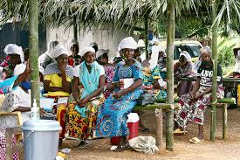
The Richness of African Culture and the Vital Role of Gender Awareness
African culture is a vast, diverse tapestry woven from numerous traditions, languages, and customs. It encompasses a rich heritage that influences daily life, from social structures and community practices to art and rituals. One critical aspect of African culture that has significant implications for societal progress is gender awareness. This essay explores the importance of traditional African cultural practices and how gender awareness plays a crucial role in fostering equality and development within African societies.

Slide 2

Abstarct English
This essay explores the richness of African culture and highlights the importance of gender awareness within African societies. African culture is a complex mosaic of traditions that reflect the continents diverse heritage. Traditional aspects such as art , music and social structure play an important part in community life. The essay discusses how traditional gender roles have historically influenced societal dynamics and emphasizes the critical need for gender awareness to promote equilitiy and empower women

Slide 3

Muhtasari Kiswahili
Insha hii inachunguza utajiri wa utamaduni za Kiafrika na kuangazia umuhimu wa uelewa wa jinsia katika jamii za Afrika.Utamaduni wa Kiafrika ni mchanganyiko wa mila,Sanaa,na kanuni za kijamii ambazo zinakisi urithi wa bara hilo.Tamaduni za jadi,Sanaa,muziki,na miundo ya kijamii zina jukumu muhimu katika kuunda Maisha ya jamii.Insha hii inajadili jinsi majukumu ya jadi ya kijinsia yalivyokuwa na athari katika mienendo ya kijamii na inasisitiza umuhimu wa uelewajinsia ili kukuza usawa na kuwawezesha wanawake.

Slide 4

Abstract(kimeru)
Mathomo maya mareareia utajiri bwa utamanduni bwa Afrika na mantu mara maina umuhimu kiri njinsia ya Afrika.Utamaduni bwa afrika ni muvulano wa mantu metu ,into bya Sanaa,na mashano ma huli na ni ya kithina kya kithina.Insha yio ithina na kithi kya njera ya kithina kaita ma wathanangire na kumwatha mwitani.kwa kutha kwa buuma ya kithina na kuthe na furu sawa,jamii za afrika zithina na ongo kutha na mwambwa wathini.

Slide 5

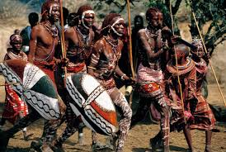
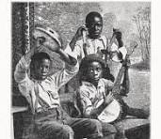
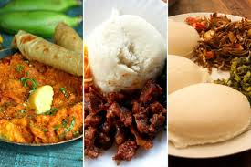
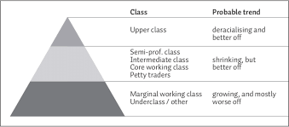
Key Aspects of African Culture
1
Traditional Practices and Rituals
African societies have a wealth of traditional practices and rituals that mark important life events, such as birth, puberty, marriage, and death. These rituals are not only vital for preserving cultural heritage but also serve to reinforce social norms and values.
2
Art and Music
Art and music are integral to African culture, serving as expressions of identity, history, and social values. Traditional art forms, such as sculptures, beadwork, and textiles, often convey symbolic meanings and tell stories about community life. Music and dance are essential in celebrations and ceremonies, reflecting the rhythms and emotions of various cultural experiences.
3
Cuisine
The culinary diversity of Africa reflects its cultural richness. Traditional dishes vary greatly across regions, incorporating local ingredients and cooking methods. Cuisine plays a role in cultural identity and community bonding, as meals are often shared during social gatherings and festivals.
4
Social Structures
Traditional African societies are typically organized around family and community structures. Extended families often live together or close by, and communal living fosters strong social ties and support networks. Roles within the family and community are influenced by cultural norms and practices.

Slide 6

The Role of Gender in African Culture
Traditional Gender Roles
Social Norms
Cultural Expressions
In many African societies, men have traditionally held positions of authority and responsibility, while women's roles have been centered around the home and family. These roles have been influenced by cultural norms, which often place men in leadership and decision-making positions, while women are tasked with caregiving and domestic duties.
Gender norms shape various aspects of life, including family structures, educational opportunities, and employment. Social expectations often dictate the behavior and opportunities available to individuals based on their gender, which can perpetuate inequality and limit personal development.
Gender is also represented in African art, stories, and rituals. While traditional art and storytelling may reflect historical gender roles, they also provide a medium for expressing and challenging cultural norms.

Slide 7

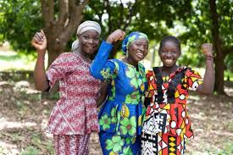
Importance of Gender Awareness in African Society
Promoting Equality
Gender awareness helps challenge and dismantle discriminatory practices and beliefs. By advocating for equal opportunities and rights for both men and women, societies can work towards achieving gender parity in education, employment, and leadership roles.
Empowering Women
Gender awareness initiatives focus on empowering women by improving access to education, healthcare, and economic opportunities. Empowering women leads to improved outcomes for families and communities, as women contribute significantly to societal development.
Changing Perceptions
Addressing and changing traditional stereotypes and biases is essential for creating a more inclusive society. Gender awareness can help shift perceptions, allowing individuals to pursue their aspirations regardless of their gender.
Social Progress
Gender equality is a key driver of social and economic development. Societies that embrace gender equity are better positioned to achieve sustainable progress and improve overall quality of life for their members.

Slide 8

Challenges and Opportunities
1
Education and Advocacy
Increasing access to education and advocacy programs can help raise awareness and promote gender equality. Educational initiatives that focus on gender issues can empower individuals to challenge traditional norms and advocate for change.
2
Policy and Legislation
Implementing and enforcing policies that support gender equality is crucial. Governments and organizations play a key role in creating and upholding laws that protect women's rights and promote equal opportunities.
3
Community Involvement
Grassroots movements and local organizations are instrumental in driving change. By engaging communities in discussions about gender and supporting local initiatives, positive change can be fostered from within.

Slide 9





Traditions and Cultural Richness
Masks
Music
Textiles
Sculpture
African masks are incredibly diverse, each with its own unique design, symbolism, and purpose within cultural traditions. They are often used in rituals, ceremonies, and performances, representing the connection between the physical and spiritual worlds.
Music is an integral part of African culture, with a wide range of traditional instruments, rhythms, and styles that vary across different regions. Music is closely tied to storytelling, spiritual practices, and community events, fostering cultural identity and unity.
African textiles, such as colorful woven fabrics, intricate embroidery, and intricate patterns, are a testament to the region's rich artistic heritage. These textiles are not only aesthetically pleasing but also serve as a means of cultural expression, often carrying symbolic meanings and representing community values.
African sculpture, ranging from small figurines to large, imposing statues, is a deeply significant art form. These works often depict deities, ancestors, or important figures, and are imbued with spiritual and cultural significance, serving as a bridge between the physical and metaphysical realms.

Slide 10

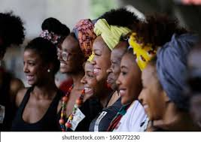



Embracing Gender Equality
Recognition
Acknowledging the valuable contributions of women in African societies is a crucial first step towards gender equality. This recognition helps challenge traditional biases and paves the way for greater representation and leadership opportunities.
Inclusive Policies
Implementing policies that actively promote gender equality in areas such as education, healthcare, and employment can create more equitable opportunities for both men and women, empowering individuals to reach their full potential.
Community Engagement
Engaging communities in dialogues about gender roles and advocating for change at the grassroots level can help shift cultural norms and attitudes over time. This bottom-up approach encourages local ownership and ensures that progress is sustainable.

Slide 11

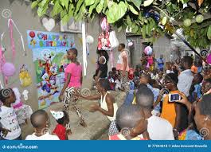
Celebrating the Diversity of African Cultures
Traditional Practices
Diverse Art Forms
Inclusive Societal Structures
Rituals, ceremonies, and customs that preserve cultural heritage and reinforce social values.
Varied expressions of identity, history, and community through mediums like sculpture, textiles, and music.
Strong family and community ties, with roles and responsibilities influenced by cultural norms.
African culture is a rich tapestry that encompasses a wide range of traditions, art, and social structures. By embracing the diversity of these cultural elements and promoting gender awareness, African societies can foster greater equality, empowerment, and sustainable development, ultimately strengthening the resilience and vibrancy of their communities.

